Slide 1
CMPSC 131

Slide 2
Introduction
Instructor: Dan Kahn
TA: Tatheer Zahra; Email: tzz5184@psu.edu; OH: TBA
Tools: Python 3.6 or later
Recitations are mandatory

Slide 3
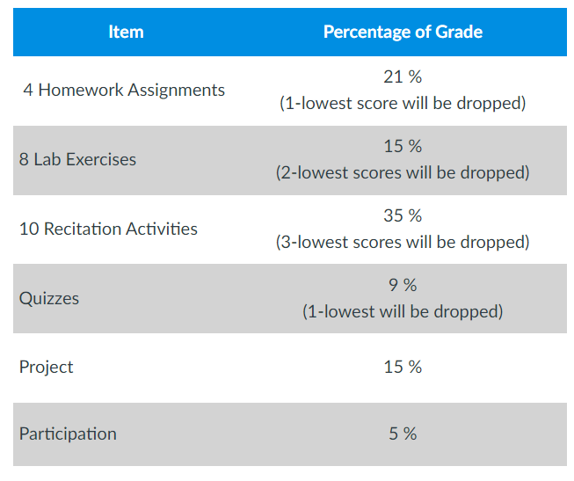
Modules

Slide 4
Week-1
How to Install Python IDLE on Windows
Writing Your First Program using Output
Variables
Comments, Operators, and Order of Operation

Slide 5
Writing Your First Program
What is output?
How do we output?
print(“Hello World”)
Double Quotes vs Single Quotes
Comma separator, line break, no space
Grammar vs Syntax of a programming language
Notes:
Comma separator lets you use both quotes

Slide 6
Variables
According to Google, a variable is anything that changes/varies
What are variables in Python?
Memory container for storing data values
Assignment vs reassignment
Notes:
Comma separator lets you use both quotes
What we have written inside is a string

Slide 7
Variables Names
Must start with an alphabet or underscore
Cannot start with a number
Can only contain alphanumeric values and underscore
Names are case sensitive i.e. Tatheer and TATHEER are two different variable names
Notes:
Comma separator lets you use both quotes
What we have written inside is a string

Slide 8
Outputting Variables
How do we output variables in Python?
print(x) or print(“x”)
Notes:
Comma separator lets you use both quotes
What we have written inside is a string

